Slide 1

Introduction to Diode and Diode Logic Gates
Lecture 7
Course No: CSE 251
Course Title: Electronic Devices and Circuits
Course instructor:
Aroni Ghosh (ARG)
Lecturer, CSE, Brac University

Slide 2
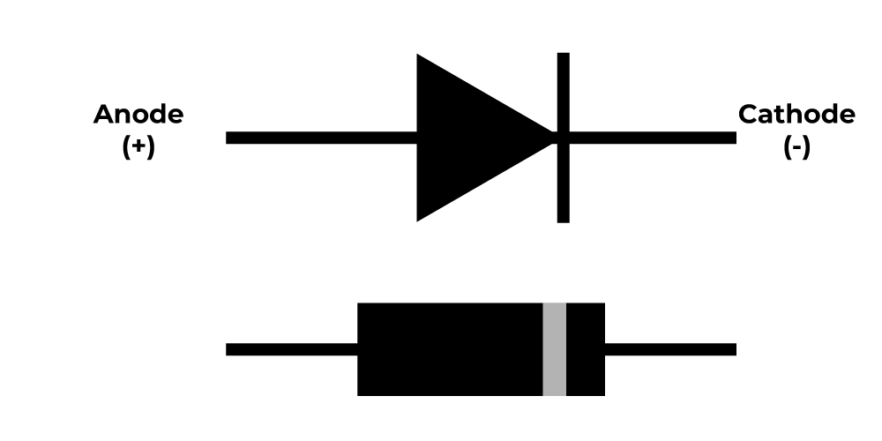
Introduction to Diode
A two terminal Non-linear device. The two terminals are: Anode (+) and Cathode(-)
The voltage difference between the terminals is expressed as, Vd= V_{anode} –V_{cathode}
The working principle of a diode can be expressed with an “Electronic Valve”. It only allows the current to flow in one direction (From Anode to Cathode). This means the diode is “ON”/ in Forward Bias only when Vd is positive (V_{anode} > V_{cathode}). This property makes it suitable as a “Rectifier”
https://www.geeksforgeeks.org/diode/

Slide 3
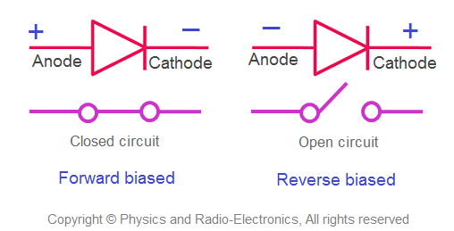
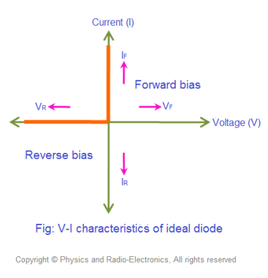
Ideal diode model and IV characteristics
In the Ideal diode model, the following conditions are assumed:
i. V_{anode}>V_{cathode}:
-The Diode will be ON - It will act as a “Short circuit”
ii. V_{anode}<V_{cathode}:
-The Diode will be OFF
- It will act as a “Open circuit”
Open circuit→ I-V: x axis
Short Circuit→ I-V: y axis

Slide 4
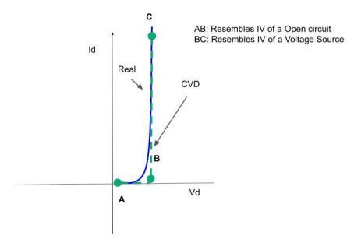
Real Diode I-V
In the Real diode model, the following conditions are assumed:
i. Vd>Vthreshold:
-The Diode will be ON
- It will act as a “Constant Voltage Source”
ii. Vd< Vthreshold:
-The Diode will be OFF
- It will act as a “Open circuit”
Open circuit→ I-V: x axis
Constant Voltage Source→ I-V: parallel to y axis

Slide 5
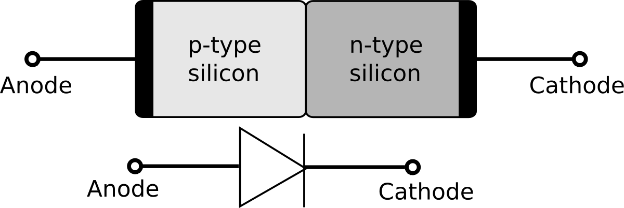
p-n junction Diode
P-type semiconductor: When an intrinsic or pure semiconductor material (Like, Silicon (Si) and Germanium (Ge)) doped with acceptor impurities atom (Trivalent atoms, like Boron (B), Gallium (G), Aluminium(Al))
N-type semiconductor: When pure semiconductor doped with donor impurities (Pentavalent atoms, like Phosphorus (P), Arsenic (As), Antimony (Sb))

Slide 6
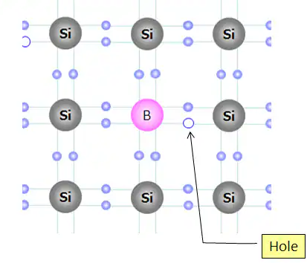
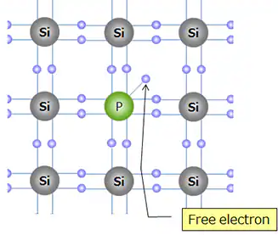
p, n type semiconductor
p- type
n- type
https://toshiba.semicon-storage.com/ap-en/semiconductor/knowledge/e-learning/discrete/chap1/chap1-4.html

Slide 7
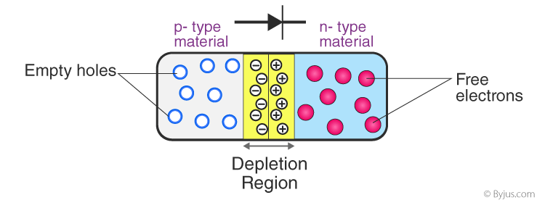
p-n junction
Threshold voltage- for silicon about 0.7V
- for germanium about 0.3V.
https://byjus.com/physics/p-n-junction/

Slide 8
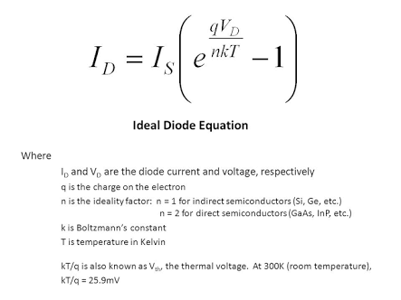
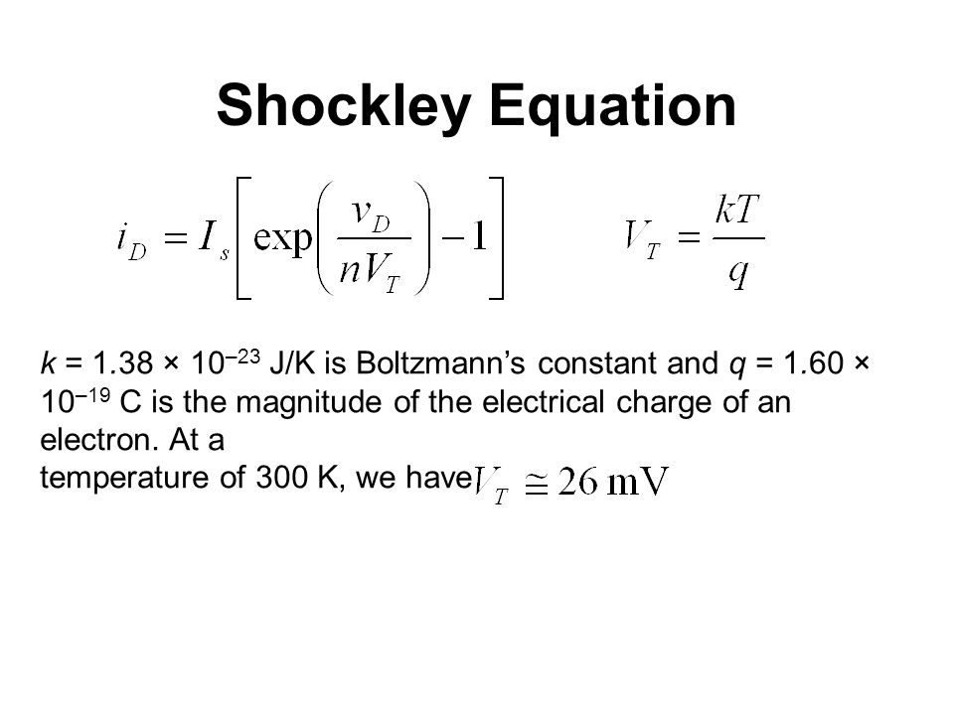
Shockley Diode Equation
Where V_{T} is Thermal Voltage
Where I_{S} is reverse saturation current

Slide 9
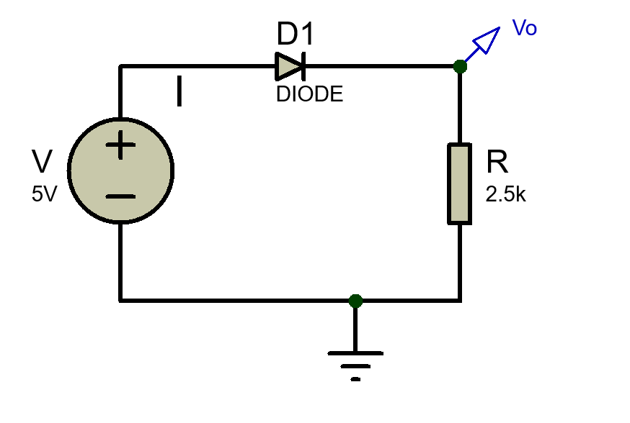
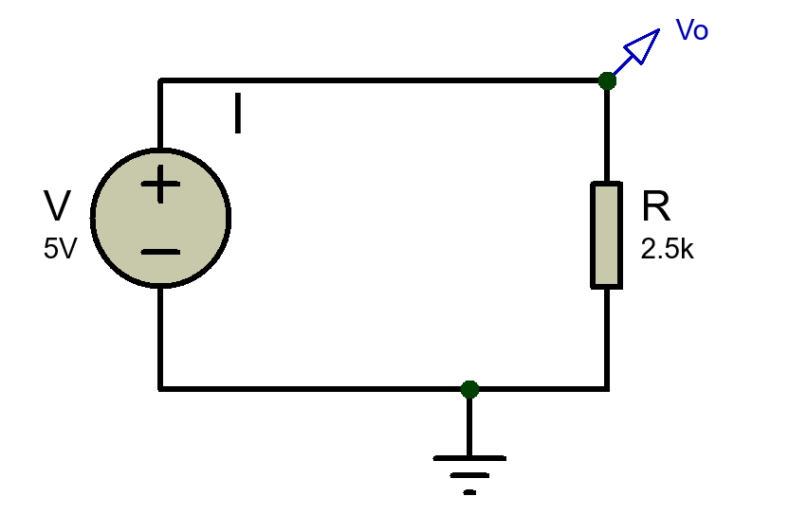
Example Problems (Ideal Diode)
Example 1:
V_{anode}= 5V
Diode is on→ replace with short circuit (Ideal Diode Model)
Vo= V= 5V
I= Vo/R= 5V/2.5kΩ= 2 mA

Slide 10
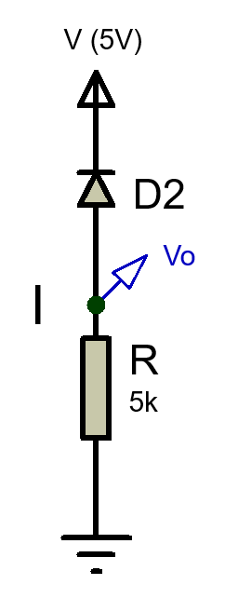
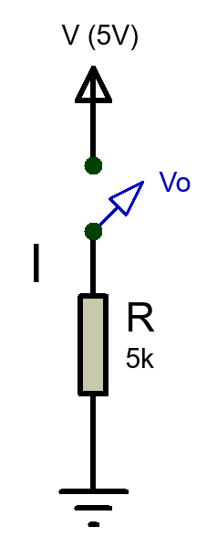
Example Problems (Ideal Diode)
Example 2:
V_{cathode}= 5V
Diode is off→ replace with open circuit (Ideal Diode Model)
As the circuit is open, I= 0 mA
Vo= 0V

Slide 11
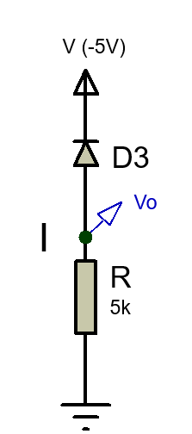
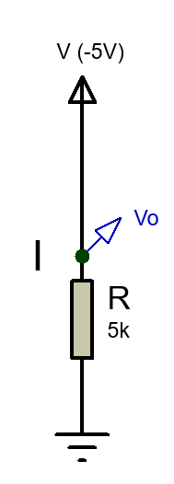
Example Problems (Ideal Diode)
Example 3:
V_{cathode}= -5V
Diode is on→ replace with short circuit (Ideal Diode Model)
Vo= -5V
I= Vo/R= -5V/5kΩ= -1 mA

Slide 12
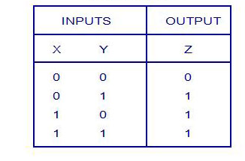
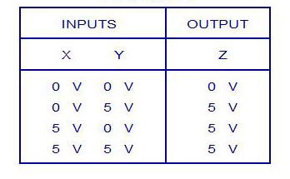
Logical Operations with Diode (OR)
Logic Truth Table
Voltage Truth Table
Low/False High/True
Logic Levels: 0 1
Corresponding voltage levels: 0V 5V

Slide 13
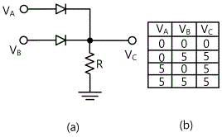
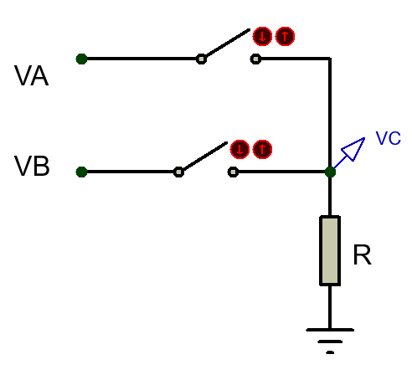
Logical Operations with Diode (OR)
D1
Case 1: V_{A}= 0V, V_{B}= 0V
Both D1 and D2 are off as V_{anode}<V_{cathode}
Replace D1 and D2 with open circuits.
So, V_{C}= 0V
D2
R is a Pull Down Resistor which pulls down the voltage of V_{C} from floating condition to 0V.

Slide 14
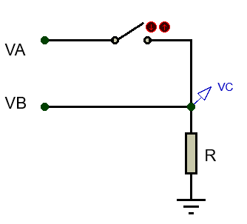
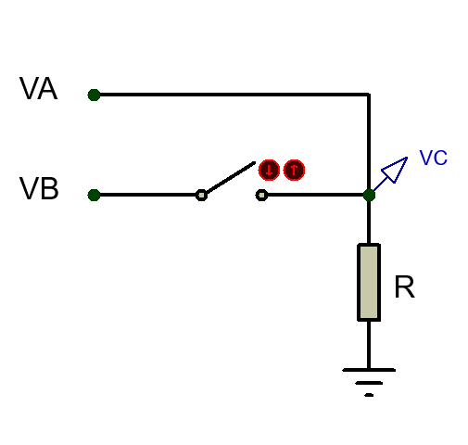
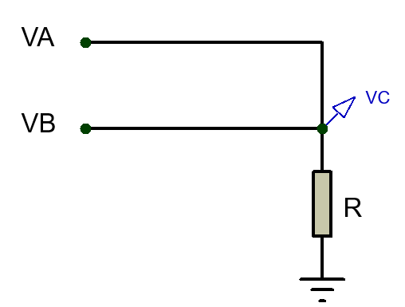
Logical Operations with Diode (OR)
Case 2: V_{A}= 0V, V_{B}= 5V
D1 is off and D2 is on
Replace D1 with open circuit and D2 with short circuit.
So, V_{C}= V_{B}= 5V
Case 3: V_{A}= 5V, V_{B}= 0V
D1 is on and D2 is off
Replace D1 with short circuit and D2 with open circuit.
So, V_{C}= V_{A}= 5V
Case 1: V_{A}= 5V, V_{B}= 5V
Both D1 and D2 are on
Replace D1 and D2 with short circuits.
So, V_{C}= V_{A}= V_{B}= 5V

Slide 15
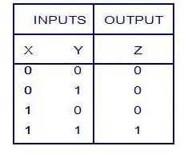
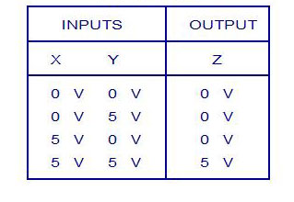
Logical Operations with Diode (AND)
Logic Truth Table
Voltage Truth Table

Slide 16
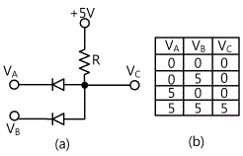
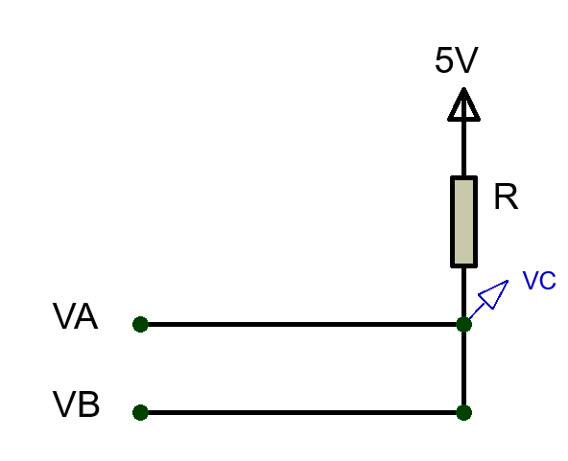
Logical Operations with Diode (AND)
Case 1: V_{A}= 0V, V_{B}= 0V
Both D1 and D2 are on as V_{anode}>V_{cathode}
Replace D1 and D2 with short circuits.
So, , V_{C}= V_{A}= V_{B}= 0V
D1
D2
R is a Pull Up Resistor which pulls up the voltage of V_{C} from floating condition to 5V.

Slide 17
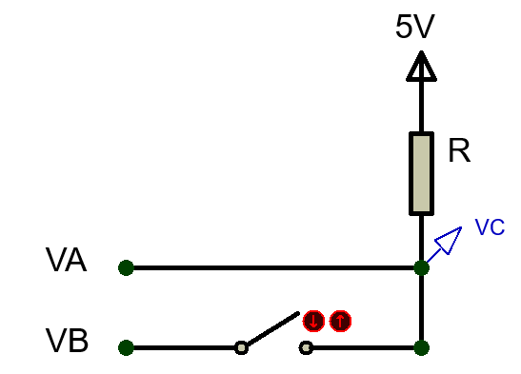
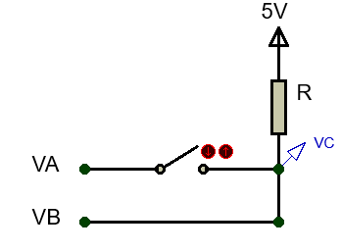
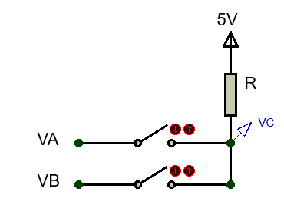
Logical Operations with Diode (AND)
Case 2: V_{A}= 0V, V_{B}= 5V
D1 is on and D2 is off
Replace D1 with short circuit and D2 with open circuit.
So, V_{C}= V_{A}= 0V
Case 3: V_{A}= 5V, V_{B}= 0V
D1 is off and D2 is on
Replace D1 with open circuit and D2 with short circuit.
So, V_{C}= V_{B}= 0V
Case 1: V_{A}= 5V, V_{B}= 5V
Both D1 and D2 are off
Replace D1 and D2 with open circuits.
So, V_{C}= 5V

Slide 18
Effect of input Voltage Variation in Logic Gates (OR)
D1
Case 1: Assuming both D1 and D2 are on
Replace D1 and D2 with short circuits.
So, V_{C} is short with both V_{A} and V_{B}
Can V_{C} be 4V and 5V at the same time???
So this assumption is wrong!
D2
If V_{A}= 4V and V_{B}= 5V, what is the value of output V_{C}?

Slide 19
Effect of input Voltage Variation in Logic Gates (OR)
Case 2: Assuming both D1 and D2 are off
Replace D1 and D2 with open circuits. So, V_{C}= 0V
But now V_{anode}(4V for D1, 5V for D2)>V_{cathode}(0V) for both diode
So this assumption is also wrong!
Case 3: Assuming D1 is on and D2 is off
Replace D1 with short circuit and D2 with open circuit. So, V_{C}= V_{A}= 4V
But now for D2, V_{anode}(5V)>V_{cathode}(4V). So, D1 should have been ON!
So this assumption is also wrong!
Case 4: Assuming D1 is off and D2 is on
Replace D1 with open circuit and D2 with short circuit. So, V_{C}= V_{B}= 5V
Now for D1, V_{anode}(4V)<V_{cathode}(5V). So, D1 should be OFF!
So this assumption is correct!

Slide 20
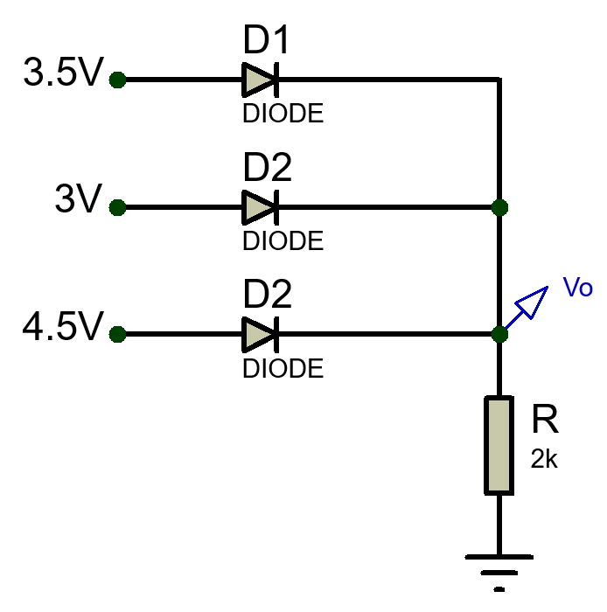
Effect of input Voltage Variation in Logic Gates (OR)
Example 4: Find the value of Vo
D1 and D2 are OFF → Open Circuit
Only D3 is ON → Short Circuit
Vo= 4.5V
Current, I= 4.5V/2kΩ= 2.25 mA

Slide 21
Effect of input Voltage Variation in Logic Gates (AND)
Case 1: Assuming both D1 and D2 are on
Replace D1 and D2 with short circuits.
So, V_{C} is short with both V_{A} and V_{B}
Can V_{C} be 1V and 2V at the same time???
So this assumption is wrong!
If V_{A}= 1V and V_{B}= 2V, what is the value of output V_{C}?

Slide 22
Effect of input Voltage Variation in Logic Gates (AND)
Case 2: Assuming both D1 and D2 are off
Replace D1 and D2 with open circuits. So, V_{C}= 5V
But now V_{anode}(5V)>V_{cathode}(1V for D1 & 2V for D2) for both diode
So this assumption is also wrong!
Case 3: Assuming D1 is off and D2 is on
Replace D1 with open circuit and D2 with short circuit. So, V_{C}= V_{B}= 2V
But now for D1, V_{anode}(2V)>V_{cathode}(1V). So, D1 should have been ON!
So this assumption is also wrong!
Case 4: Assuming D1 is on and D2 is off
Replace D1 with short circuit and D2 with open circuit. So, V_{C}= V_{A}= 1V
Now for D2, V_{anode}(1V)<V_{cathode}(2V). So, D2 should be OFF!
So this assumption is correct!

Slide 23
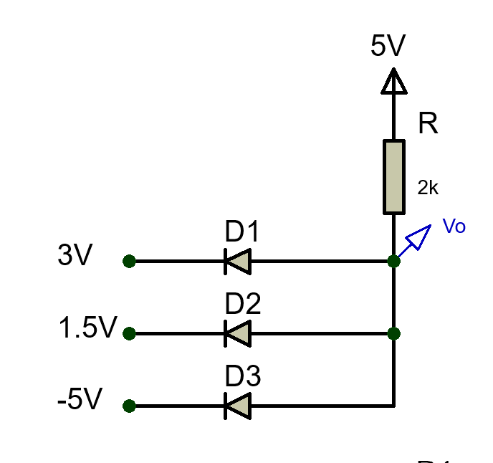
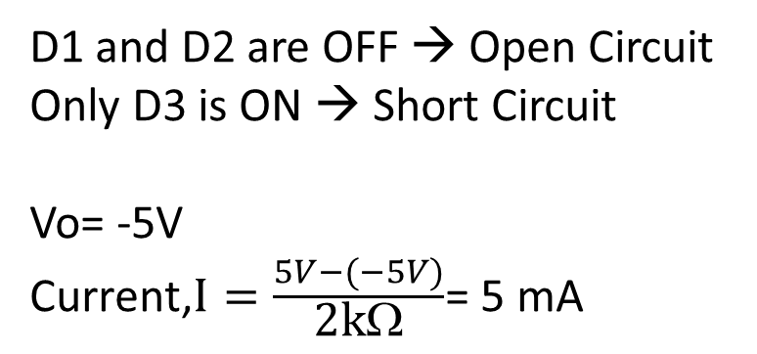
Effect of input Voltage Variation in Logic Gates (AND)
Example 5: Find the value of Vo
D1 and D2 are OFF → Open Circuit
Only D3 is ON → Short Circuit
Vo= -5V
$\text{Current}\text{,}I=\frac{5V−(−5V)}{\text{2}\text{k}\text{Ω}}$= 5 mA

Slide 24
Thank You

